Slide 1

Saudi Arabia Used Cars
Raef Salem
Shaimaa Alghamdi
Hanadi Bin Mujalli
Omar Alshamrani
Mohammed Darwish

Slide 2
01
03
05
Contents
INTRODUCTION
02
DATA PREPROCESSING
EXPLORATORY DATA ANALYSIS (EDA)
04
CHALLENGES
KEY TAKEAWAYS
06
CONTIRBUTION
07
CONCLUSION

Slide 3
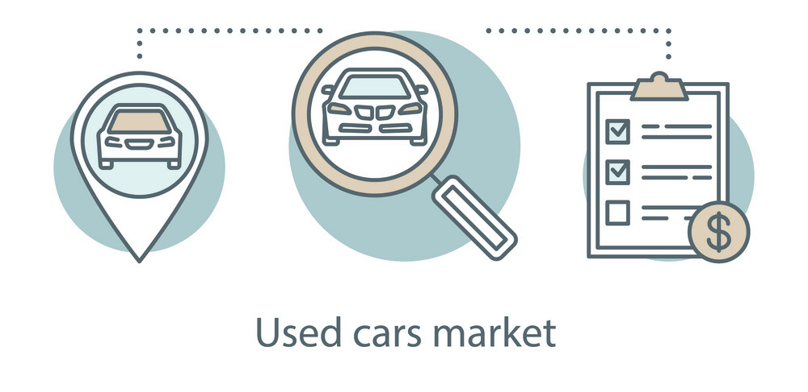
Introduction
SCENARIO
There is a foreign investor who’s interested in cars and wants to have a general idea about the used car market in KSA.
He has a few questions about the Saudi resale car market such as:
Price Range
Most Famous Companies
Most Popular Color
Factors effects the cars’ prices.

Slide 4
Introduction
DATASET
- The dataset contains 8035 records and 13 columns of used cars collected from syarah.com [1].
[1] https://syarah.com/

Slide 5
Introduction
DATASET
The dataset features are:
Features | Describtion
Make | Name of the car company
Type | Name of a car product
Year | Year of Manufacturing
Origin | Country of importer (Gulf / Saudi / Other)
Color | Color of the used car
Options | Full Options / Semi-Full / Standard
Engine_Sizesort | The engine size of used car
Fuel_Type | Fuel type size of used car (Diesel / Gas / Hybrid)
Gear_Type | Automatic / Manual
Mileage | The average distance that a vehicle can travel on (in km)
Region | The region in which the used car was offered for sale
Price | Price of the used car (in SAR)
Negotiable | If True, the price is 0. This means the price is negotiable (not set)
[1] https://syarah.com/

Slide 6
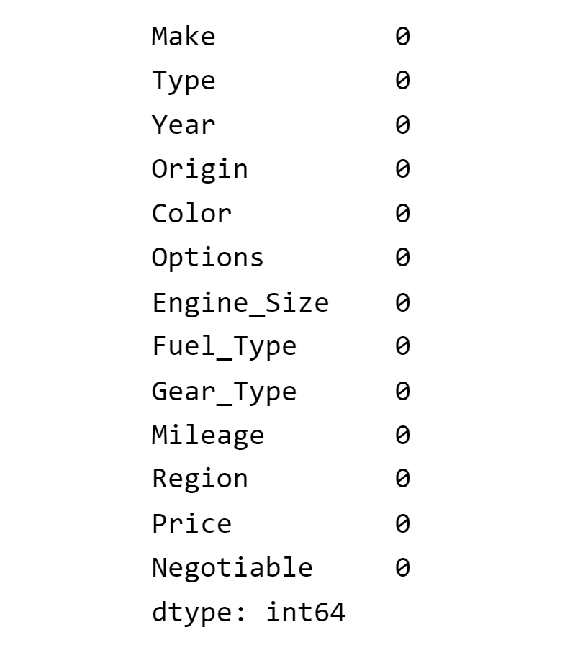
DATA PREPROCESSING
Check The Missing Values
Check The Duplicated Rows
Deal With Price Column
Notes:
check rows with Price represented as'0’
Drop the rows having price equal to zero
Dropping the rows having price equal to > 70000 in order to avoid skewing the results.

Slide 7
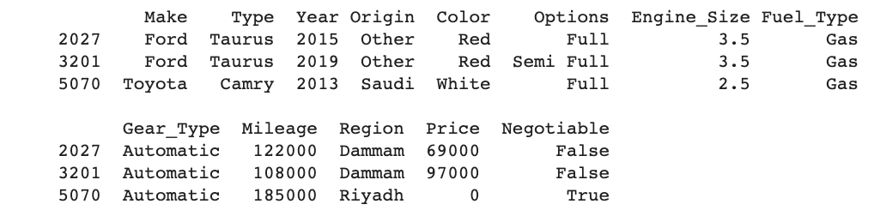
DATA PREPROCESSING
Check The Missing Values
Check The Duplicated Rows
Deal With Price Column
Notes:
check rows with Price represented as'0’
Drop the rows having price equal to zero
Dropping the rows having price equal to > 70000 in order to avoid skewing the results.

Slide 8
DATA PREPROCESSING
Check The Missing Values
Check rows with Price represented as ’0’.
Drop the rows having price equal to zero.
Drop the rows having price less than 7000.
Check The Duplicated Rows
Deal With Price Column
Notes:
the price is nogi…..
----------
Reasonable

Slide 9
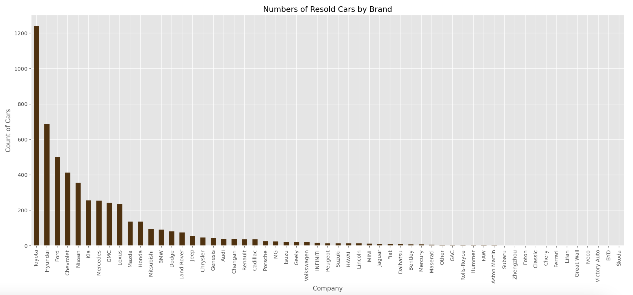
What Is The Average Price In Each Region?
EXPLORATORY DATA ANALYSIS (EDA)
What Is The Most Famous Car Companies?
Toyota, Hyundai, and Ford are among the most resold cars.

Slide 10
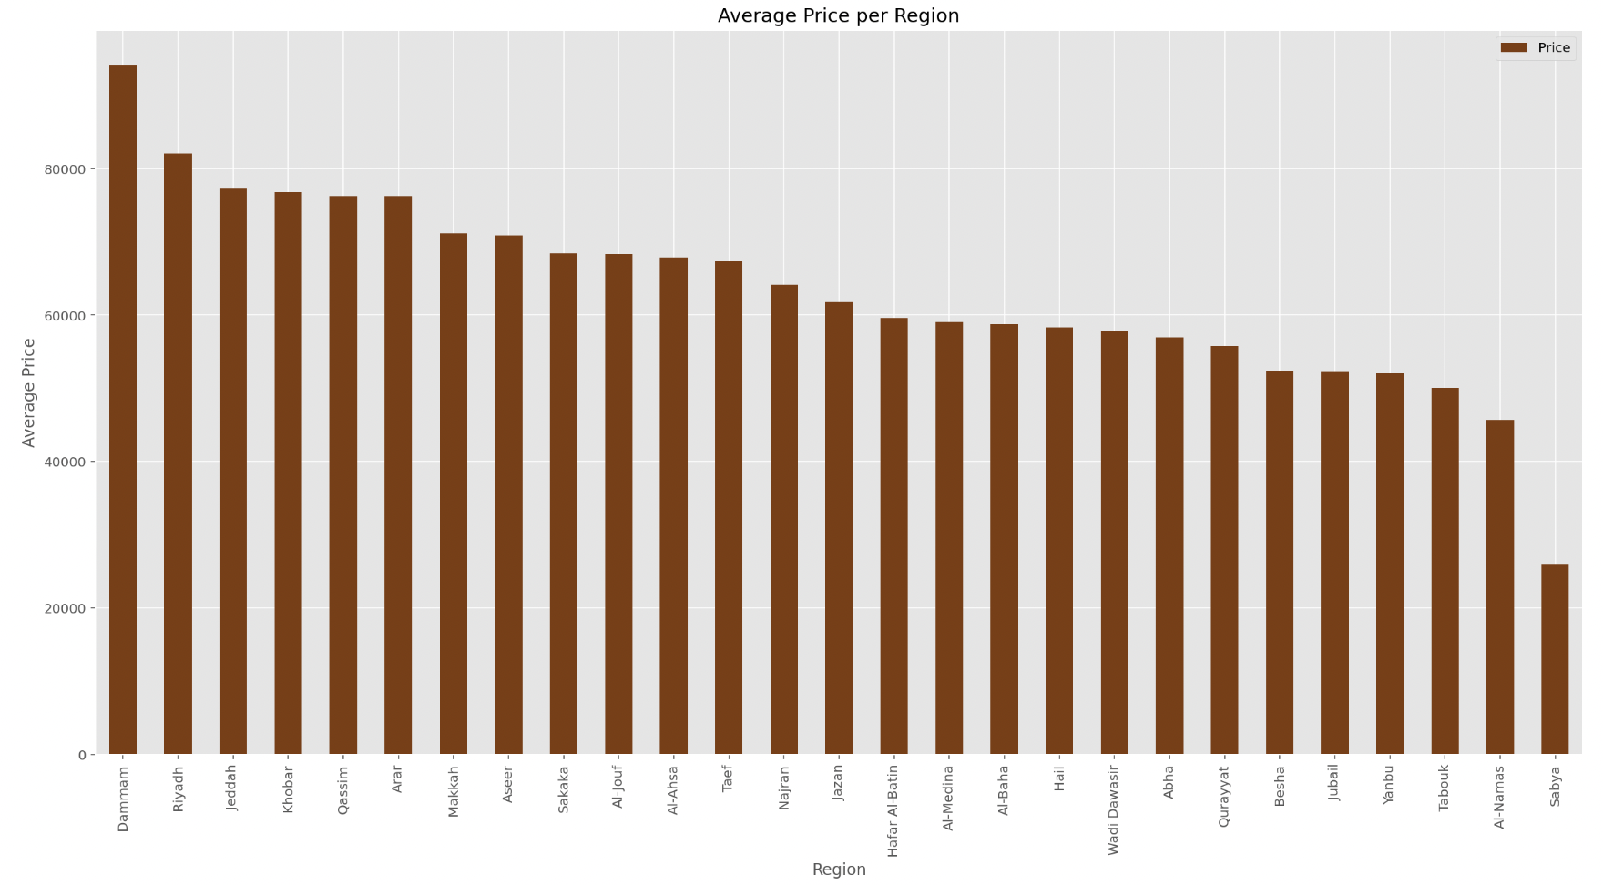
What Is The Average Price In Each Region?
EXPLORATORY DATA ANALYSIS (EDA)
What Is The Most Famous Car Companies?
Dammam, Riyadh, and Jeddah cities have the highest average price.

Slide 11
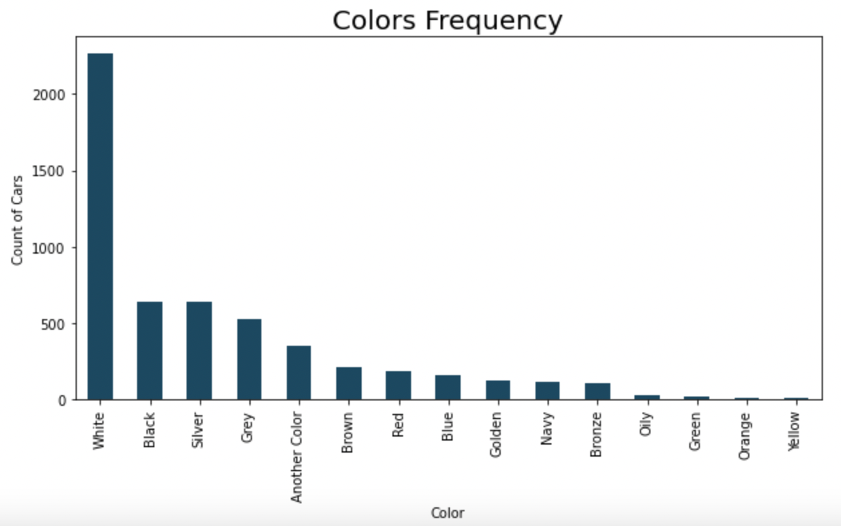
What Is The Most Popular Cars Color?
EXPLORATORY DATA ANALYSIS (EDA)
What Is The Resold Cars Price?
How does the price differ in each company and model year.
White, black & silver are the most common colors whereas green, orange & yellow are the least frequent.

Slide 12
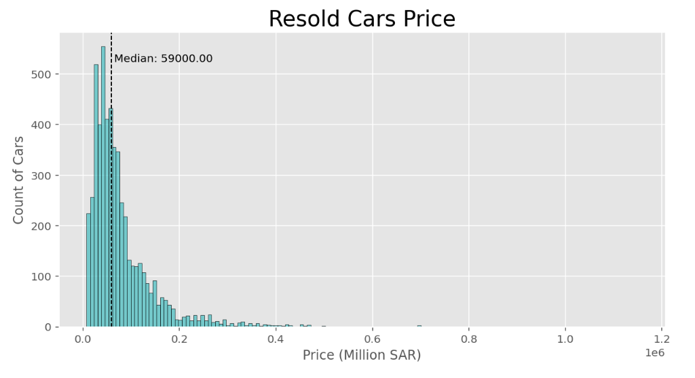
What Is The Most Popular Cars Color?
EXPLORATORY DATA ANALYSIS (EDA)
What Is The Resold Cars Price?
How does the price differ in each company and model year.
Price was positively skewed; the median is 59000 SAR.

Slide 13
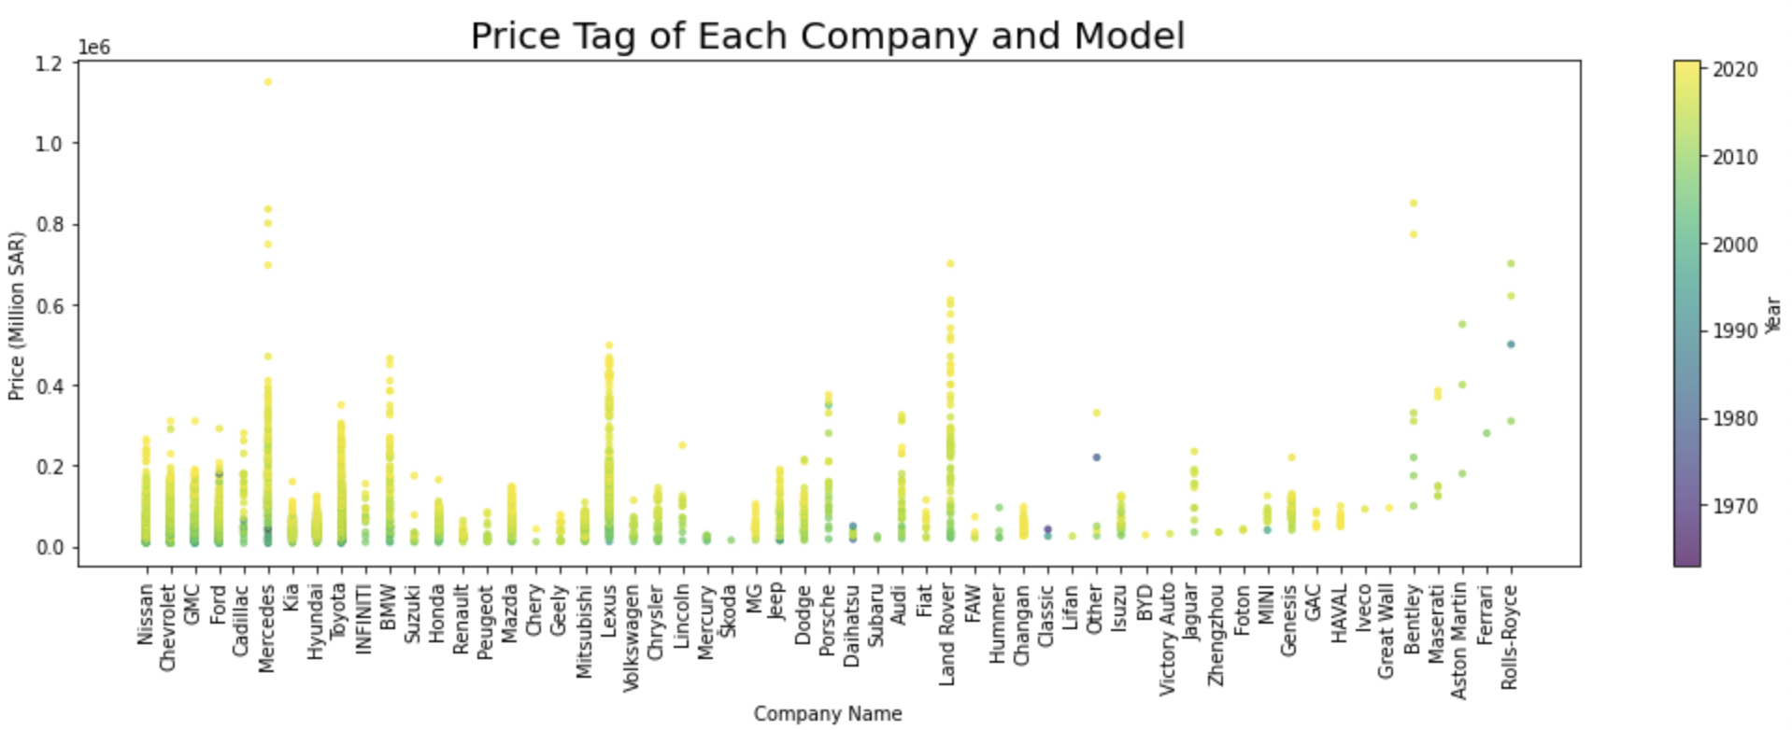
What Is The Most Popular Cars Color?
EXPLORATORY DATA ANALYSIS (EDA)
Price in each company and model year
What Is The Resold Cars Price?
How does the price differ in each company and model year
Mercedes has the highest price followed by Bentley.
In general, the newer the car the higher the price.

Slide 14
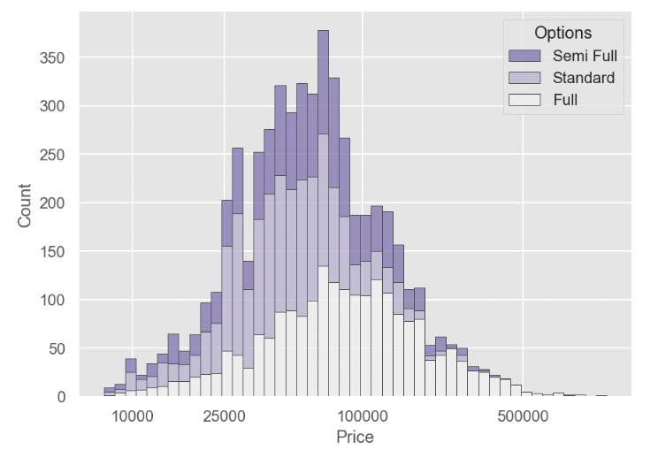
Which Cars Options Are Most Popular, and Does that affect the Price?
EXPLORATORY DATA ANALYSIS (EDA)
How Does The Fuel Type Change Overtime? (Toyota As An Example)
Semi full option cars are the least sold cars, while most of the sold cars are full option, in general.
As the price increases, the sold cars are more likely to be full option.

Slide 15
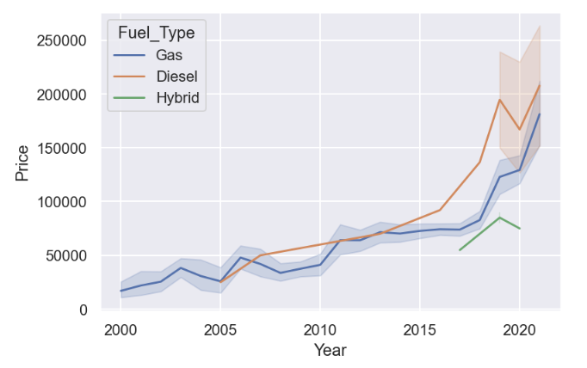
Which Cars Options Are Most Popular, and Does that affect the Price?
EXPLORATORY DATA ANALYSIS (EDA)
How Does The Fuel Type Change Overtime? (Toyota As An Example)
As an example, we took the sample of Toyota cars (as Toyota has the higher frequency) from 2000 onward. We see that Diesel used cars had lower prices in 2005, but with the time it got higher than Gas used cars. Moreover, note the behavior of the Hybrid used cars.

Slide 16
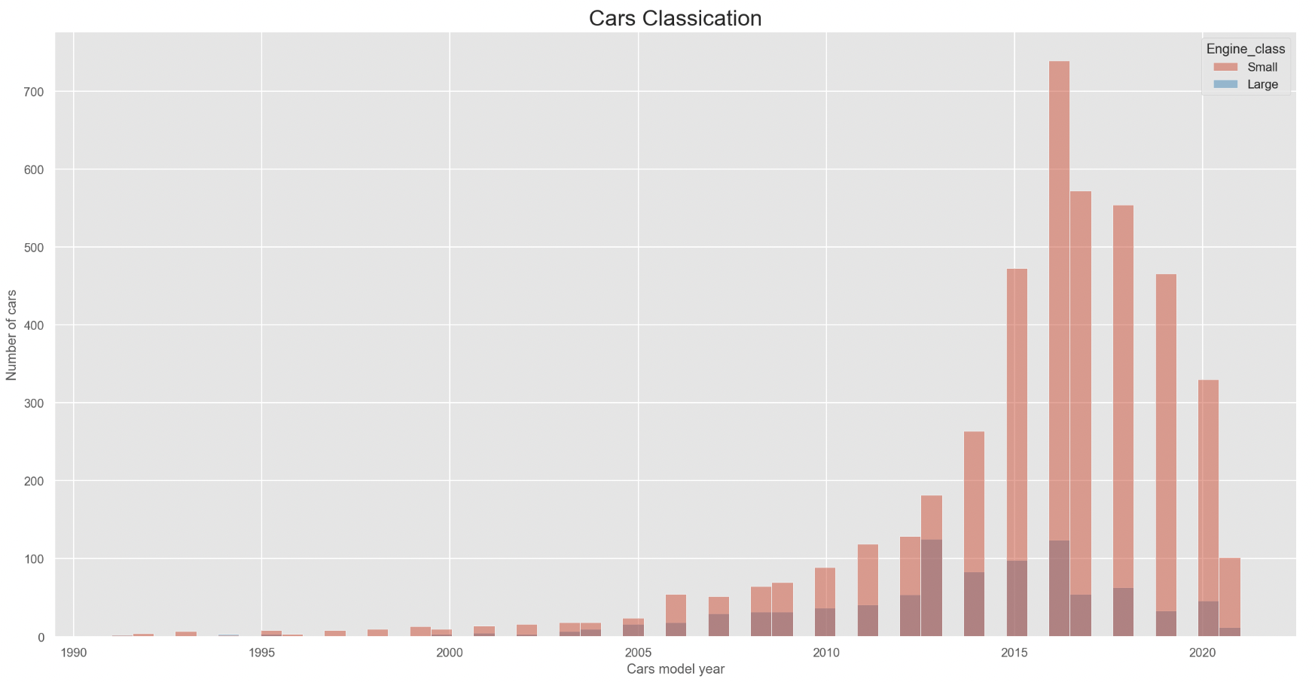
Does The Engine Class Proportion Change In The New Model Cars?
EXPLORATORY DATA ANALYSIS (EDA)
Correlation Matrix To Show Which Variable Affect The Price For The Overall Dataset
More Analysis To See What Is The Variable That Affect The Price For The Top Car Makers?
The cars listed on the website with a model from 2014 onward are dominated by small engine whereas the older cars have almost an equal proportion.
Notes:
Optuna --

Slide 17
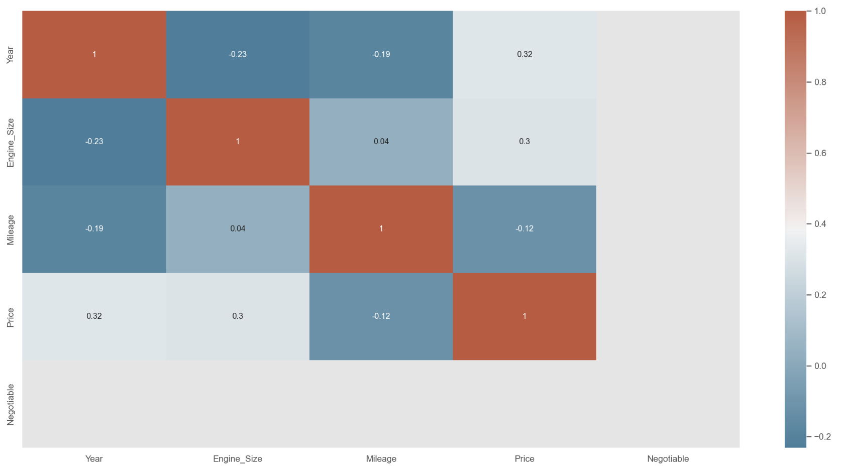
Does The Engine Class Proportion Change In The New Model Cars?
EXPLORATORY DATA ANALYSIS (EDA)
Correlation Matrix To Show Which Variable Affect The Price For The Overall Dataset
More Analysis To See What Is The Variable That Affect The Price For The Top Car Makers?
The engine size and the model year have a similar positive effect and the model year has the highest effect on the price for the overall dataset.
Notes:
Optuna --

Slide 18
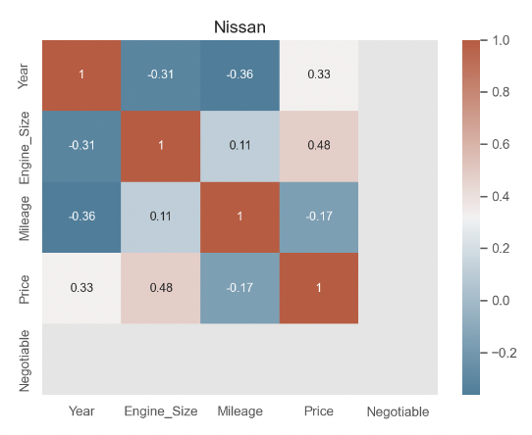
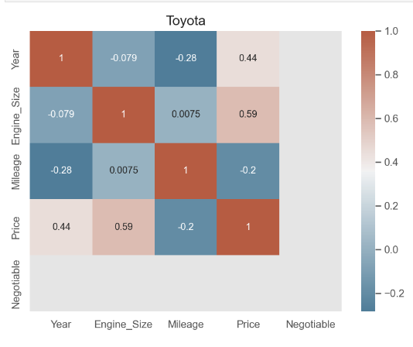
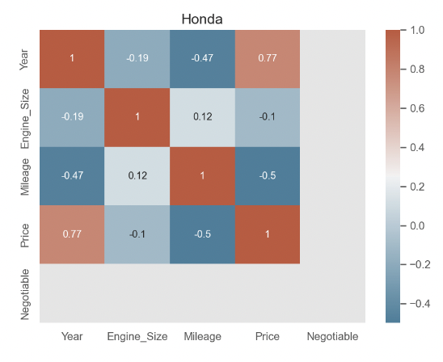
Does The Engine Class Proportion Change In The New Model Cars?
Correlation Matrix To Show Which Variable Affect The Price For The Overall Dataset
More Analysis To See What Is The Variable That Affect The Price For The Top Car Makers?
In Toyota and Nissan, the engine size has the highest positive effect with the price, in the other hand, Honda engine size has a negative effect on the price.
Notes:
In Toyota and Nissan, the engine size has the highest positive effect with the price, in the other hand, Honda engine size has a negative effect on the price.

Slide 19
CHALLENGES
Prepare the selected dataset.
Combine the code in one Notebook.
Choose the appropriate types of plots.

Slide 20
KEY TAKEAWAYS
We can tell the interested investor that according to the EDA in our dataset:
Toyota is the most famous company and Aston Martin is the least famous.
Dammam has the highest average price compared with other cities.
White is the most popular car color unlike yellow color.
The median was 59000 SAR.
The price increase as the model year increase, and the cars are more likely to be a full option.
The prices of Toyota cars with Diesel fuel increased overtime.
For the overall data set the model year has the highest effect on the price, but for Toyota and Nissan it is the engine size.

Slide 21
CONTRIBUTION
Name | Contribution
Raef Salem | Two plots, GitHub repo, RawScript, and Readme File.
Shaimaa Alghamdi | Data preprocessing, two plots, and the presentation.
Hanadi Bin Mujalli | Three plots and the presentation.
Omar Alshamrani | Three plots.
Mohammed Darwish | Data preprocessing, Six plots, and the report.

Slide 22
REFERENCES
[1] https://syarah.com
[2] https://www.kaggle.com/datasets/turkibintalib/saudi-arabia-used-cars-dataset

Slide 23
THANKYOU
Any Questions?

